Slide 1
Syndicate-Based Prediction Model for the BangladeshiMarket
Rashel hossain
ID: 241162
PMIT, Jahangirnagar University

Slide 2
Project overview
This study investigates the use of machine learning to detect anomalous pricepatterns in commodity markets, which may indicate potential syndicate activity.Syndicates often manipulate market prices, causing irregular fluctuations that canbe identified through sophisticated anomaly detection methods. Unlike previous re-search, which achieved an accuracy of 65-75% using limited algorithms and lackeda user interface, our approach incorporates hybrid algorithms and a user-friendlyinterface, achieving accuracy rates between 96% and 98%. We employed several ma-chine learning models, including Isolation Forest, Random Forest, and AdaBoost, toanalyze historical market price data. These models were trained and tested usingperformance metrics such as accuracy, precision, recall, F1-score, and ROC-AUC.Among these, AdaBoost demonstrated the best performance, with 99.39% accuracy,perfect precision (1.0), and a high F1-score (0.988). The optimal model, selectedfor its balanced recall and precision, was integrated into a Flask web application forreal-time anomaly detection. This system provides a reliable method for identifyingpotential syndicate activities, thereby enhancing market analysis and decision-makingprocesses. The findings highlight the effectiveness of machine learning in detectingprice anomalies and its potential to improve financial fraud detection in commoditymarkets.

Slide 3
Problem Statement
The economy of Bangladesh appears sound, but the market is a hotbed of syndi-cation, whether formal or informal, and is unstable. Syndicates of garment exporters,of fuel and food importers, of banking and micro-finance, groups of informal tradersin agriculture, in real estate all regularly exert anomalous leverage on the supply, theprice, policy. These forces are not all captured in the official economic data, leavingpockets of concern for policy makers, price gyrations and investment risks. There is apressing demand for a syndicate-based forecasting model to be established in order toinvestigate, and extract insights from, the underlying dynamics of the capital marketof Bangladesh

Slide 4
Motivation
eing at the threshold of rapid economic development in a process of becoming amiddle-income country, Bangladesh is a significant contribution to studying marketperformance in the LDCs.
However, these sort of standard macroeconomic modelsoften understate the hidden power of market cartels, informal networks, trade associ-ations, and sector-based coalitions, which have strong say over pricing, flow of supplyand investment.
The objective of this study is to offer a coalition-based predictionmodel that involves the formal and informal economy, so as to help policy makersand firms to a greater extent in forecasting at different levels of analysis.

Slide 5
Objectives
To Distinguish and classify the various forms of market syndicates in Bangladeshimarket economy (export, import, financial, informal and digital.
To Examine how these cartels impact on price stability, trading patterns, andinvestment directions.
To Construct a predictive model which integrates the macroeconomic forecast-ing and syndicate analysis in the network.
To Make recommendations to help policy makers and businesses to decreasevolatility and to make better choices.

Slide 6
Limitations
Dependence on second source for economic indicators.
If Resources are limited, Sectoraldepth could be compromised.
Sudden global shocks (e.g., pandemics, geopolitical conflicts) might affect the predictive accuracy.

Slide 7
Potential Challenges
Balancing model accuracy with interpretability.
Risk of overfitting due to limited or imbalanced datasets.
High computational cost for large datasets.
Policy-level adoption of predictive analytics.

Slide 8
Methodology
Steps followed:
Data Collection (BANBEIS, school surveys)
Data Preprocessing (cleaning, encoding, normalization)
Model Training & Cross-validation
Performance Evaluation
Algorithms: SVM, Random Forest, Decision Tree, XGBoost, Gradient Boosting, KNN, Logistic Regression, Naive Bayes.

Slide 9
Comparative Analysis
Aspect | AI-Driven Market Anomaly Detection Paper (2024) | Market Syndicate Detection Project
Focus | Detecting market anomalies and optimizing asset allocation. | Detecting price anomalies to identify syndicate activity in commodity markets.
Algorithms Used | Large language models, graph neural networks, reinforcement learning. | Hybrid machine learning algorithms (Isolation Forest, Random Forest, AdaBoost).
Accuracy | Accuracy not specified; focus on optimization rather than precise anomaly detection. | Achieved 96% to 98% accuracy with AdaBoost showing 99.39% accuracy and perfect precision.
User Interface | Not mentioned. | Includes a user-friendly interface (Flask web app) for real-time anomaly detection.

Slide 10
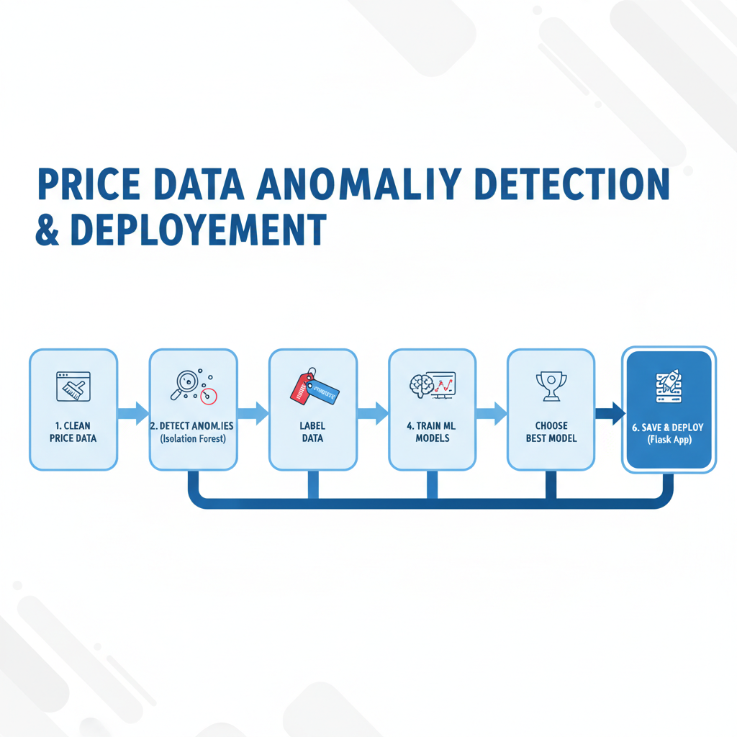
Data flow Chart
Table 2: Model Performance Comparison Based on CV Accuracy

Slide 11
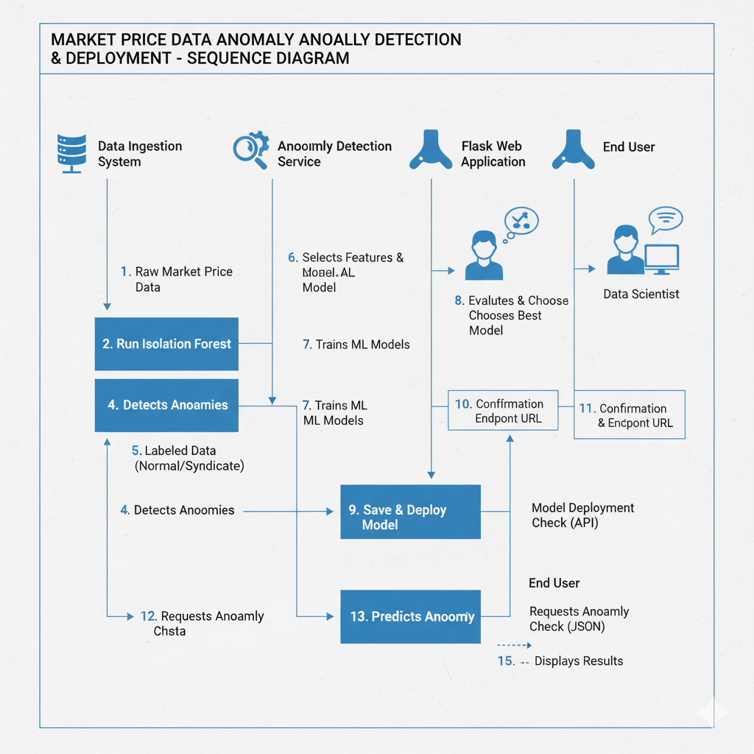
System diagram

Slide 12
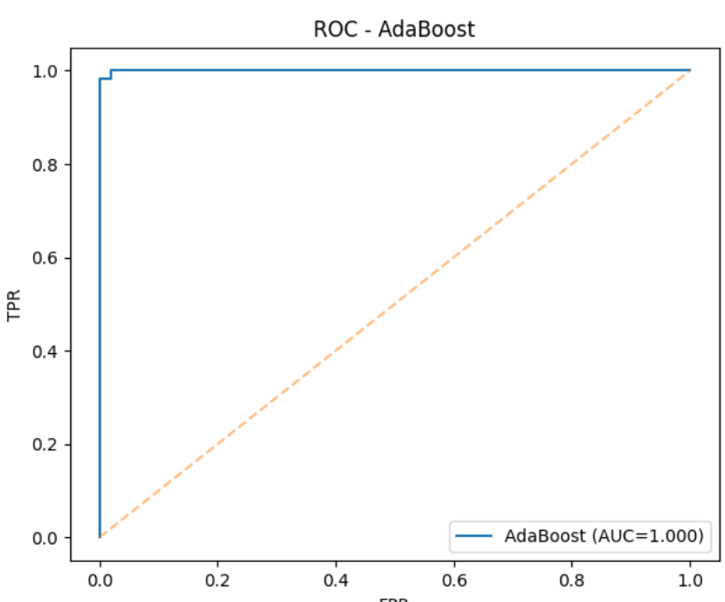
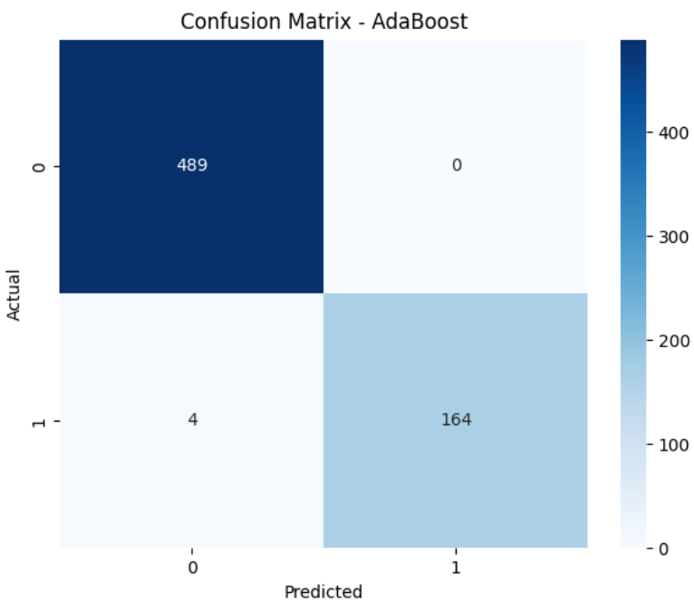
Best Model
Figure 2: Confusion matrix of Random forest
Figure 3: ROC of Random Forest

Slide 13
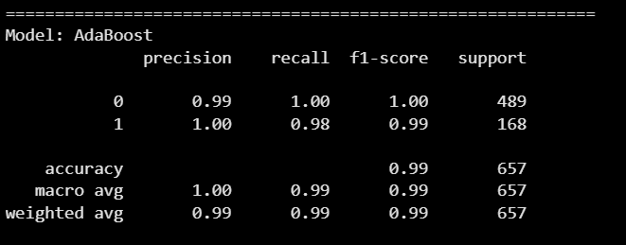
Best Model report

Slide 14
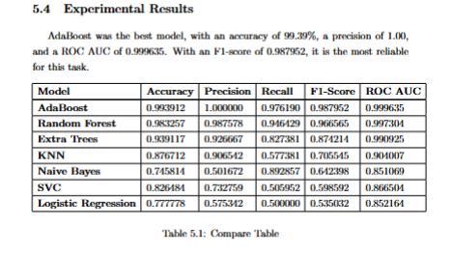
Experimental Results

Slide 15
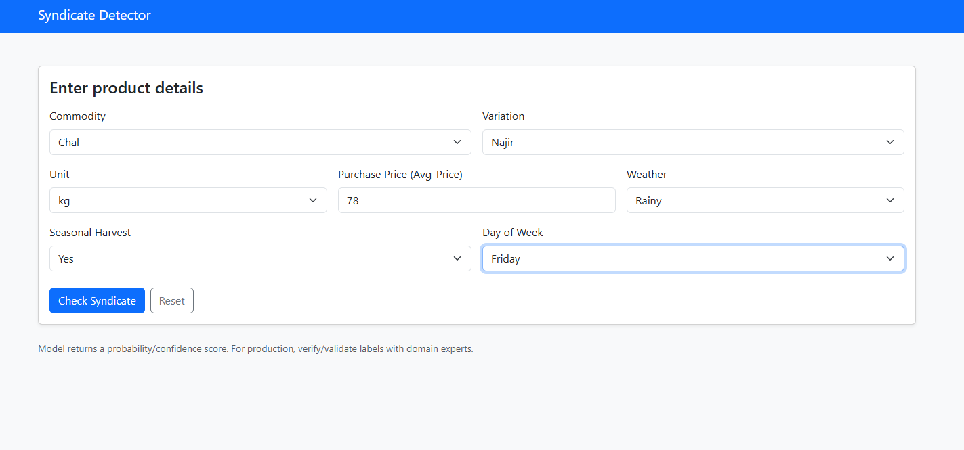
Web Interface
Figure 5: Website view

Slide 16
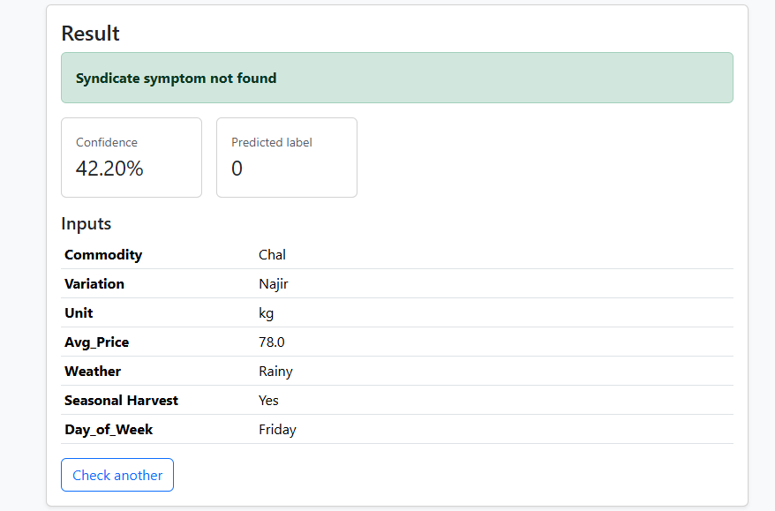
USER INTERFACE RESULT

Slide 17
Conclusion & Future Work
Conclusion:
Future Work:
The study successfully detects price anomalies in commodity markets using machine learning, identifying potential syndicate activities.
Hybrid algorithms, particularly AdaBoost, achieved high accuracy (99.39%) and precision.
A Flask-based web interface enables real-time anomaly detection, enhancing the system's practical use.
The project demonstrates the potential of machine learning in financial fraud detection and market surveillance.
Expand Datasets: Include diverse market data to improve model robustness.
Incorporate More Indicators: Add trading volumes and volatility for better anomaly detection.
Model Improvement: Experiment with deep learning and reinforcement learning models.
Automated Alerts: Implement real-time alert notifications for detected anomalies.
Cross-Market Analysis: Extend to analyze multiple commodity markets.
Real-Time Streaming: Enable real-time data streaming for faster detection.

Slide 18


